Slide 1
Advanced Encryption Standard
(AES)
Dr Arshad Farhad
Slides taken from chapter 7 of “Cryptography and Network Security” by Behrouz Forouzan

Slide 2
Objectives
❏ To review a short history of AES
❏ To define the basic structure of AES
❏ To define the transformations used by AES
❏ To define the key expansion process

Slide 3
INTRODUCTION
The Advanced Encryption Standard (AES) is a symmetric-key block cipher published by the National Institute of Standards and Technology (NIST) in December 2001.
In February 2001, NIST announced that a draft of the Federal Information Processing Standard (FIPS) was available for public review and comment. Finally, AES was published as FIPS 197 in the Federal Register in December 2001.

Slide 4
Criteria
The criteria defined by NIST for selecting AES fall into three areas:
1. Security
2. Cost
3. Implementation.

Slide 5
Rounds
AES is a non-Feistel cipher that encrypts and decrypts a data block of 128 bits. It uses 10, 12, or 14 rounds. The key size, 128, 192, or 256 bits, depends on the number of rounds.

Slide 6
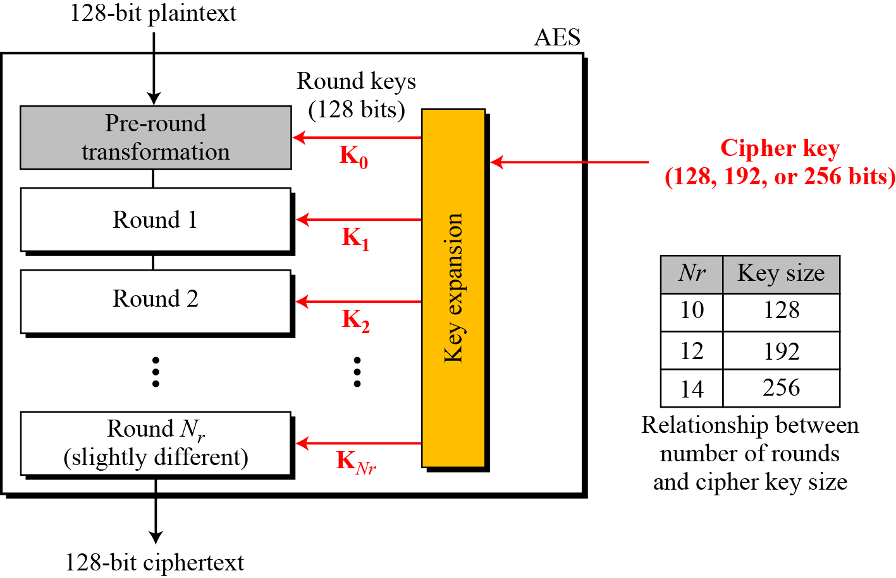
General design of AES encryption cipher

Slide 7
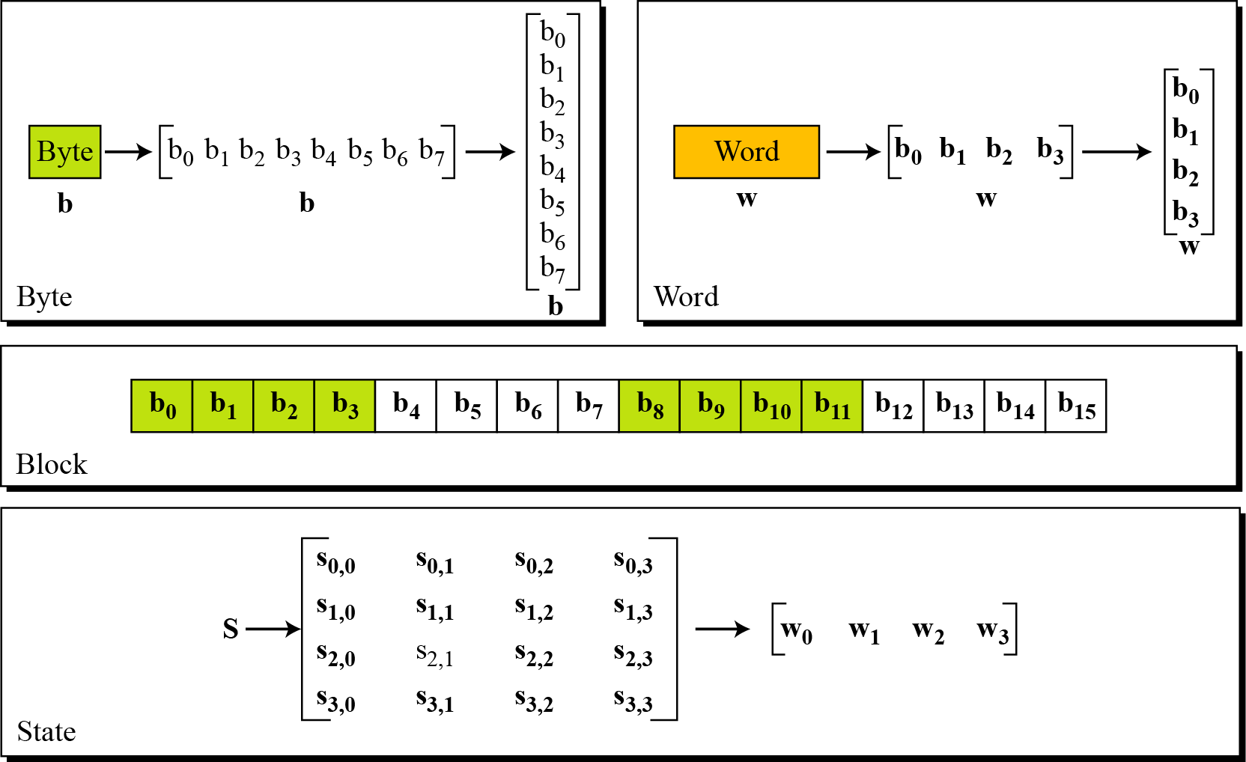
Data Units
Data units used in AES

Slide 8
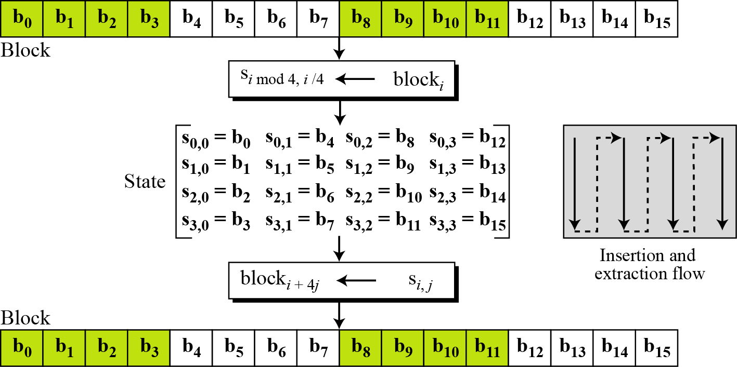
Block-to-state and state-to-block transformation

Slide 9
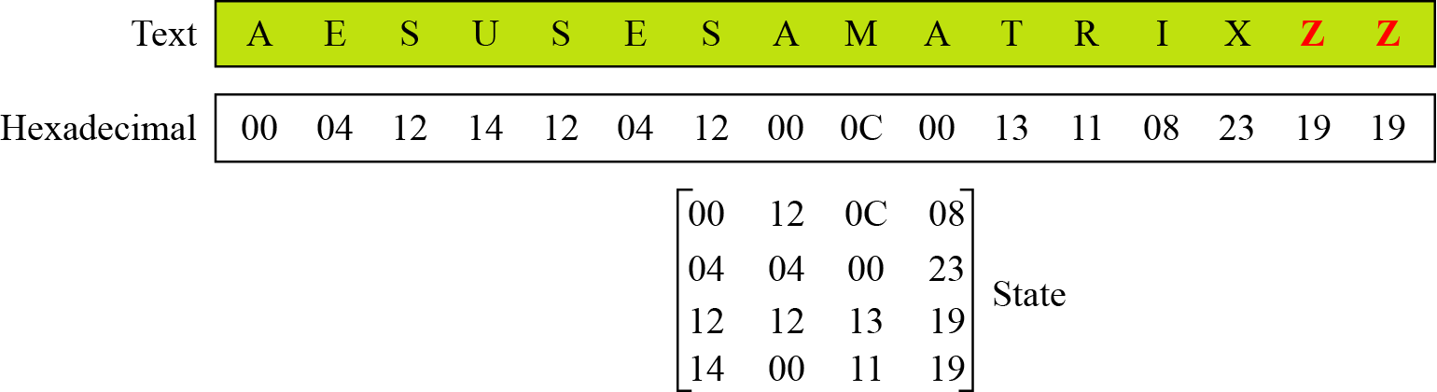
Changing plaintext to state

Slide 10
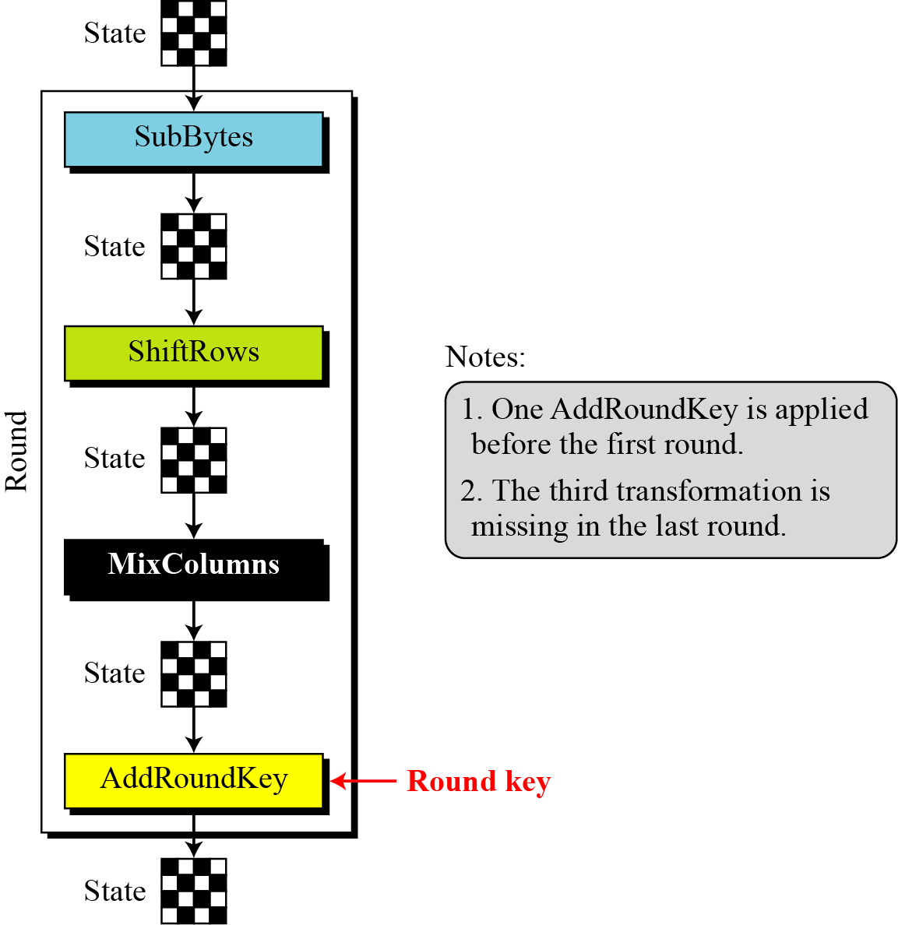
Structure of Each Round

Slide 11
TRANSFORMATIONS
To provide security, AES uses four types of transformations: substitution, permutation, mixing, and key-adding.
Topics discussed in this section:
Substitution
Permutation
Mixing
Key Adding

Slide 12
Substitution
AES, like DES, uses substitution. AES uses two invertible transformations.
SubBytes
The first transformation, SubBytes, is used at the encryption site. To substitute a byte, we interpret the byte as two hexadecimal digits.
The SubBytes operation involves 16 independent byte-to-byte transformations.

Slide 13
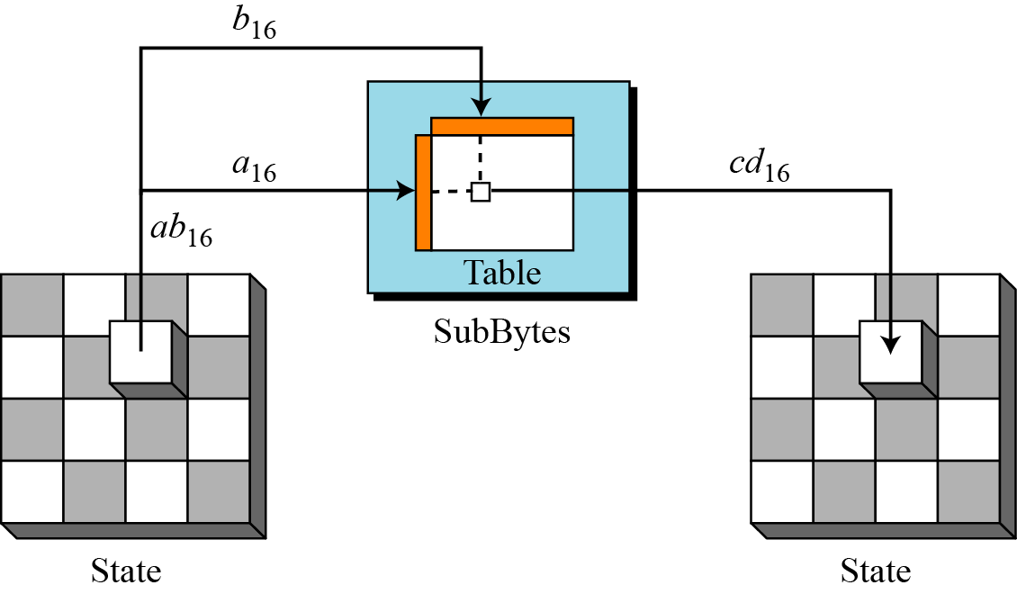
SubBytes transformation

Slide 14
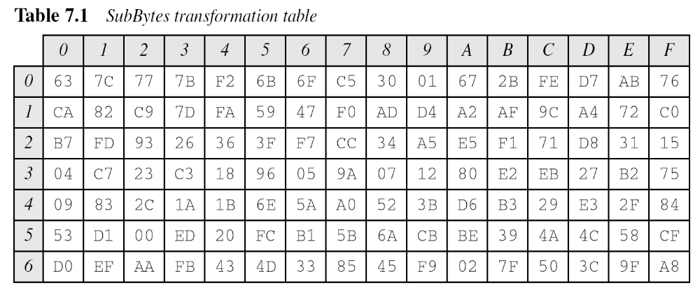
SubBytes

Slide 15
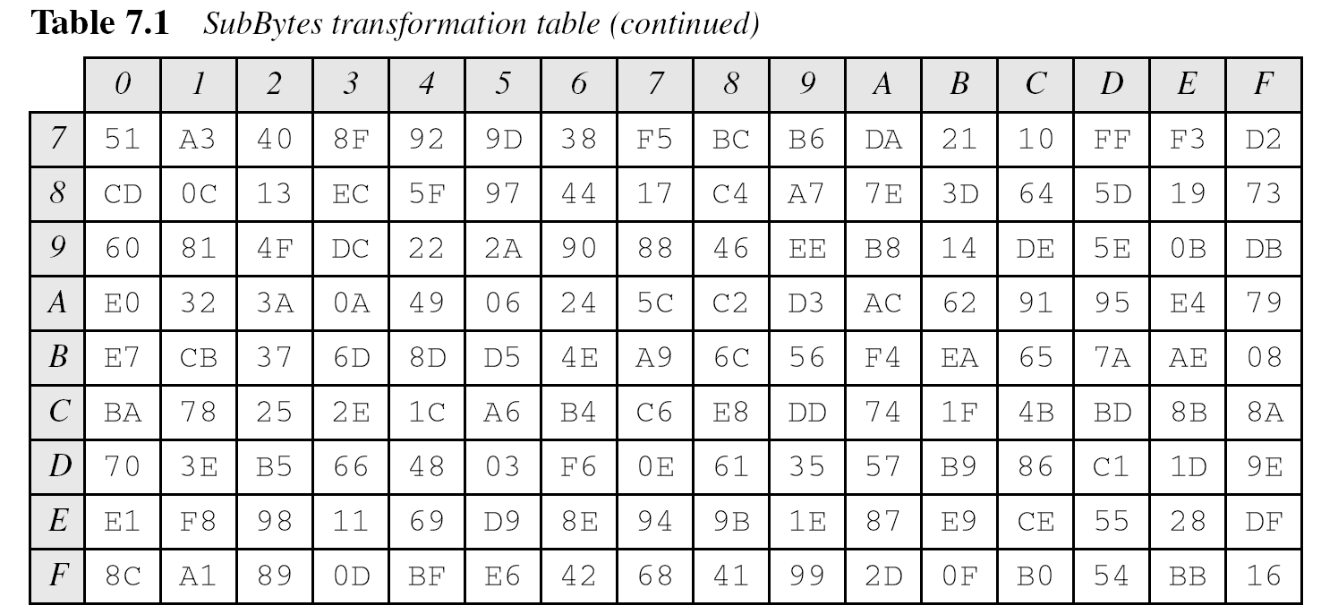
SubBytes

Slide 16
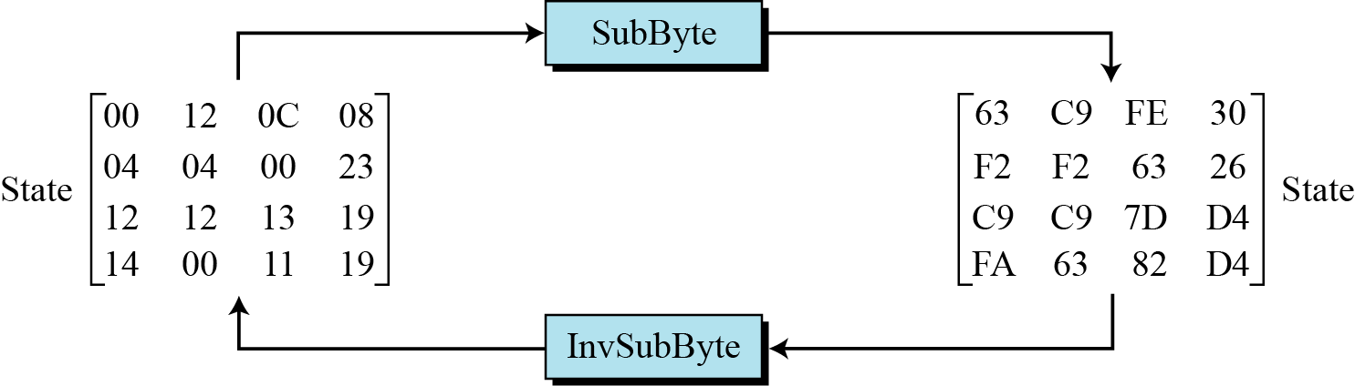
SubBytes
Figure show a state is transformed using the SubBytes transformation. The figure also shows that the InvSubBytes transformation creates the original one. Note that if the two bytes have the same values, their transformation is also the same.

Slide 17
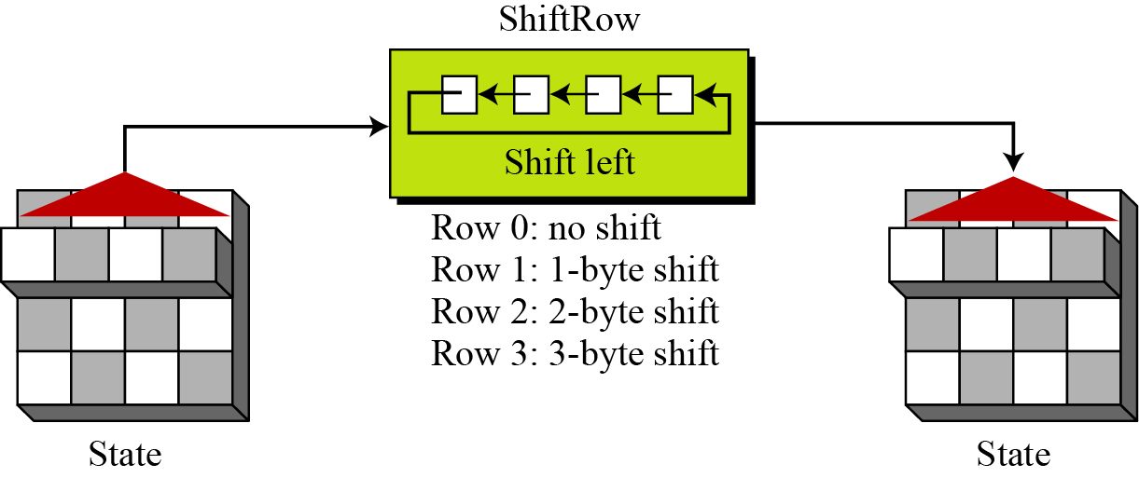
Permutation
Another transformation found in a round is shifting, which permutes the bytes.
ShiftRows
In the encryption, the transformation is called ShiftRows.

Slide 18
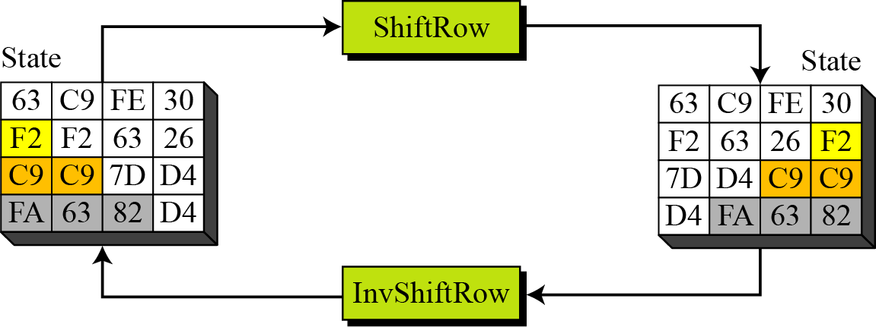
Permutation
Figure shows how a state is transformed using ShiftRows transformation. The figure also shows that InvShiftRows transformation creates the original state.

Slide 19
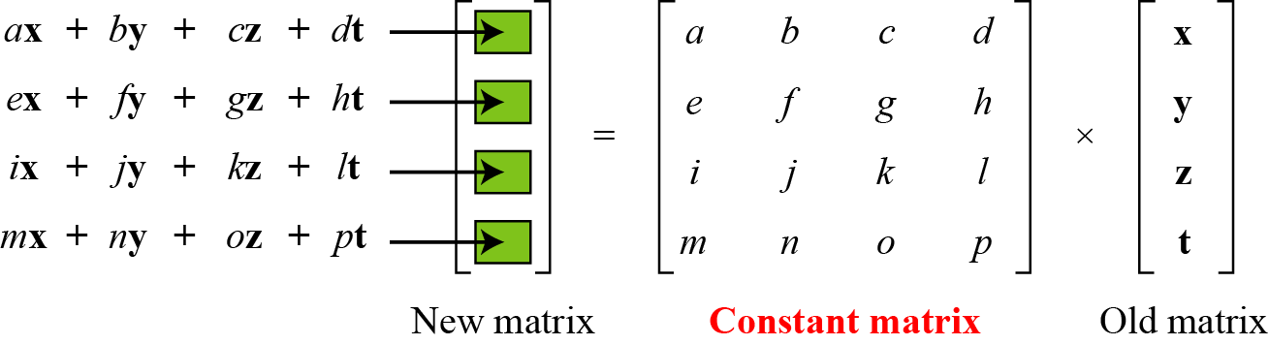
Mixing
We need an interbyte transformation that changes the bits inside a byte, based on the bits inside the neighboring bytes. We need to mix bytes to provide diffusion at the bit level.

Slide 20
Mixing
The multiplication operation is defined as:
  Multiplication by 1 means no change,
  Multiplication by 2 means shifting to the left, a conditional XOR with 0x1B (0001 1011) will be performed if the shifted value is larger than 0xFF or in other words leftmost bit of original value is 1.
  Multiplication by 3 means shifting to the left, then performing conditional XOR with 0x1B if required and then performing XOR with the initial unshifted value.

Slide 21
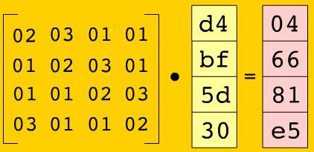
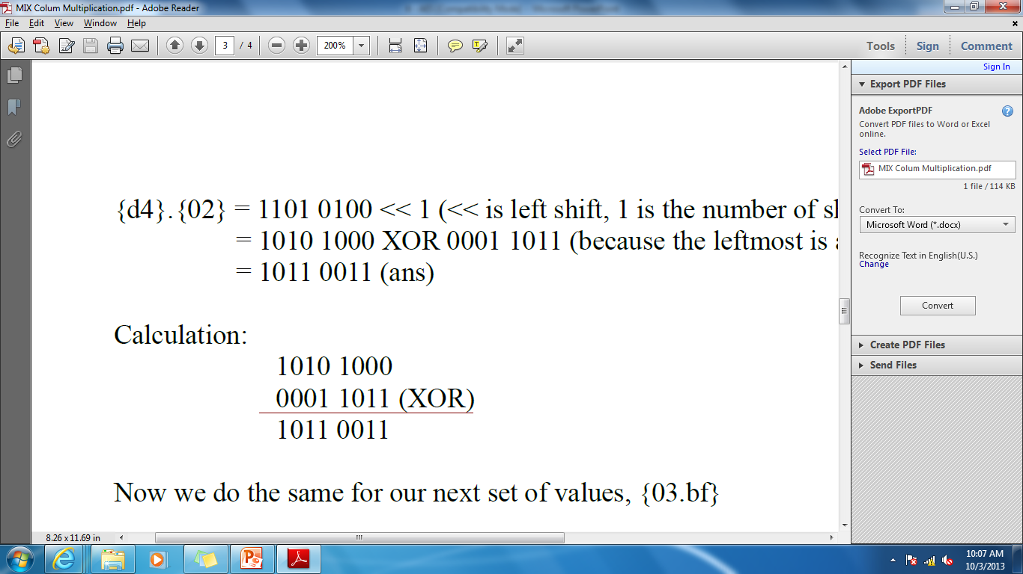
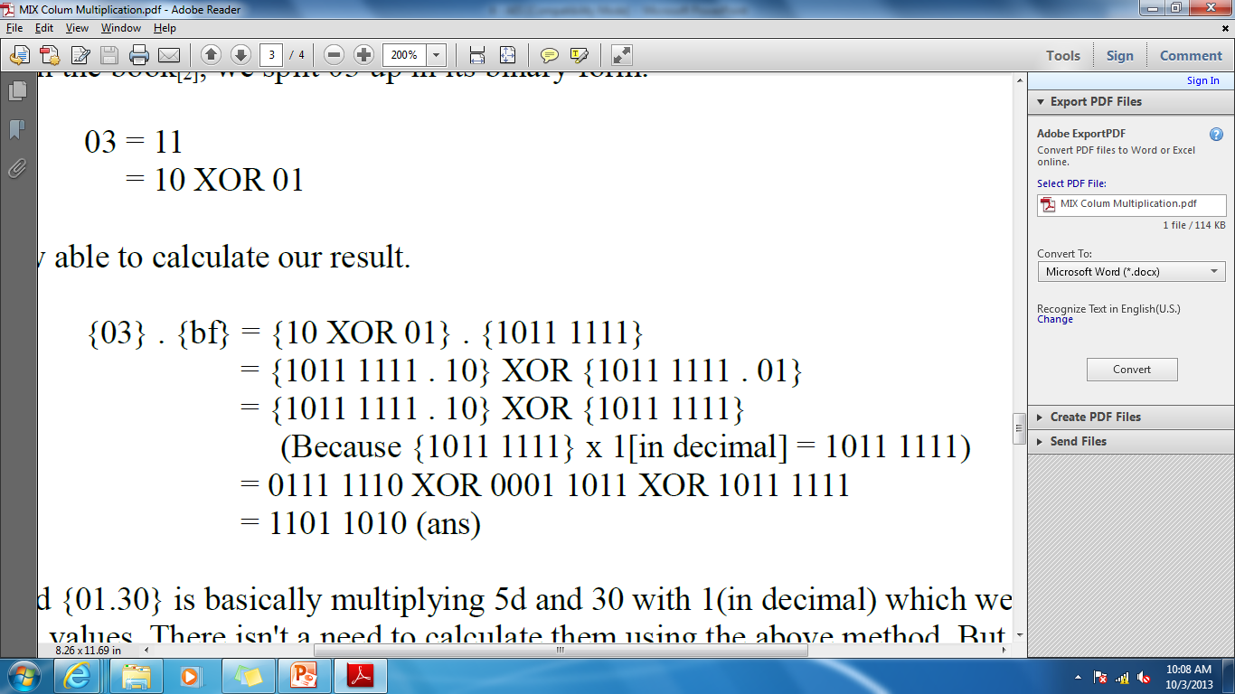
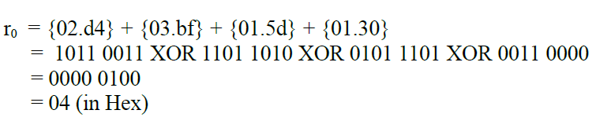

Slide 22
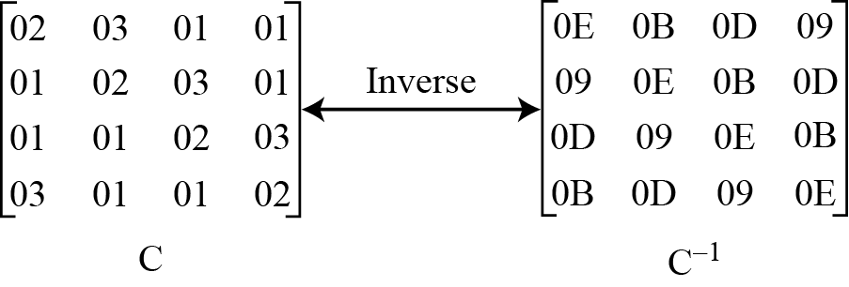
Mixing
Constant matrices used by MixColumns and InvMixColumns

Slide 23
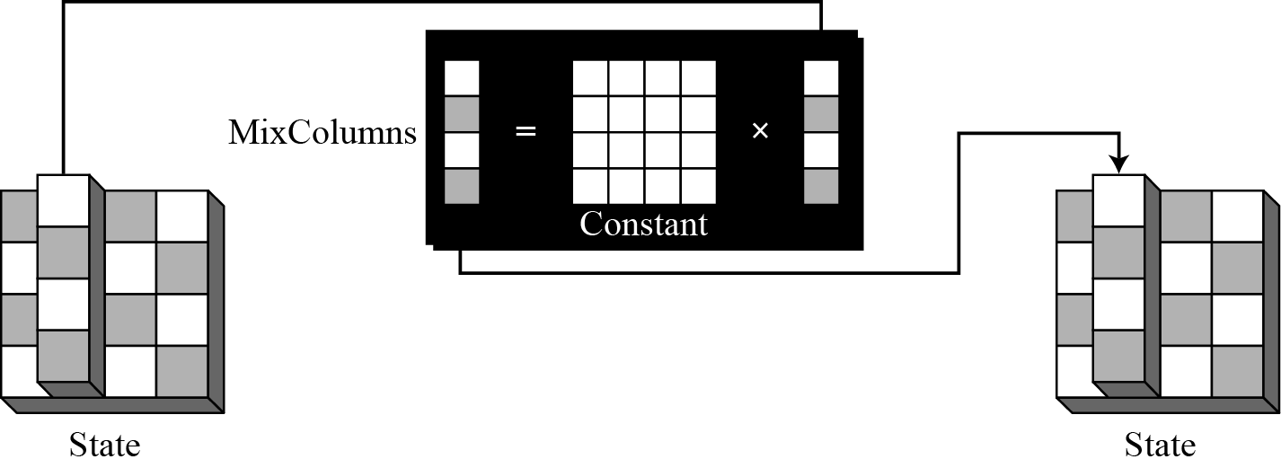
MixColumns
The MixColumns transformation operates at the column level; it transforms each column of the state to a new column.
MixColumns transformation

Slide 24
Key Adding
AddRoundKey proceeds one column at a time. AddRoundKey adds a round key word with each state column matrix; the operation in AddRoundKey is matrix addition.
The AddRoundKey transformation is the inverse of itself.

Slide 25
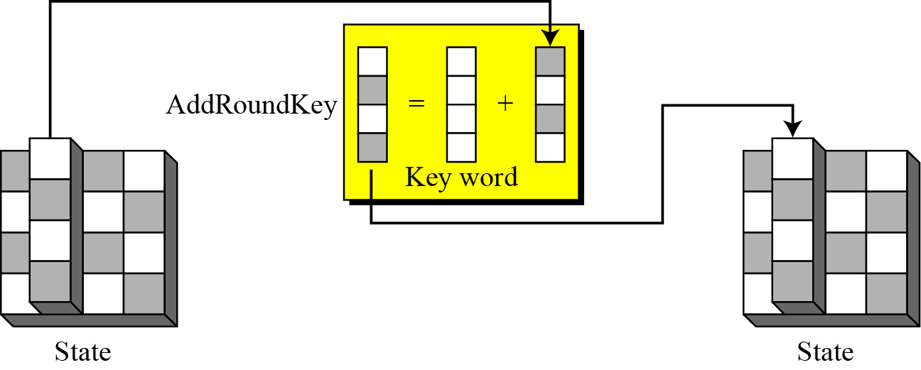
AddRoundKey transformation

Slide 26
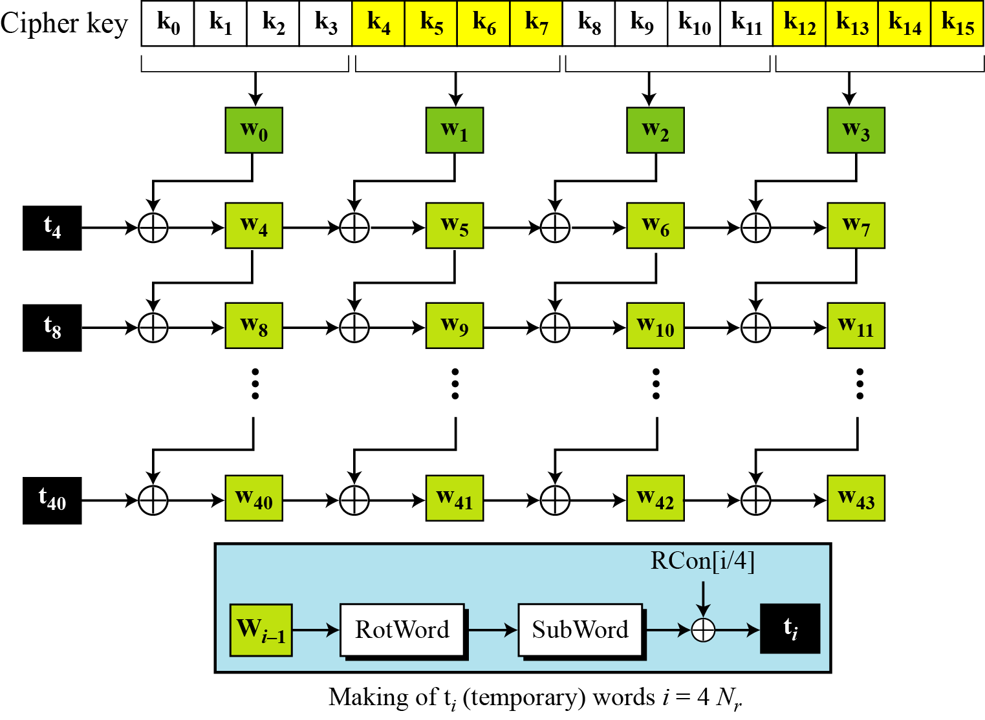
KEY EXPANSION
To create round keys for each round, AES uses a key-expansion process.

Slide 27
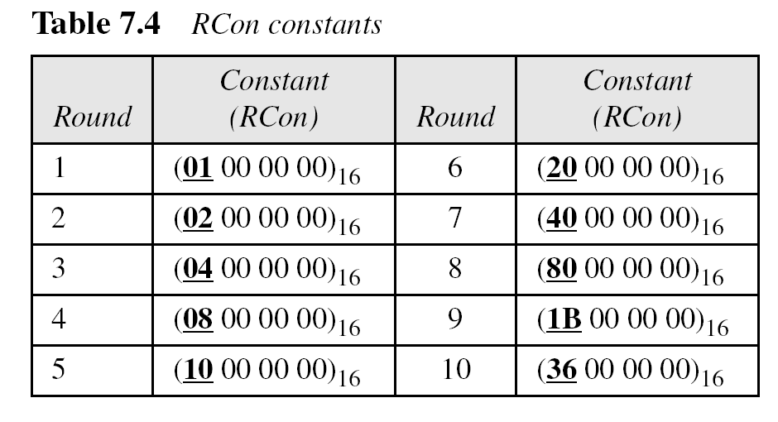
KEY EXPANSION

Slide 28
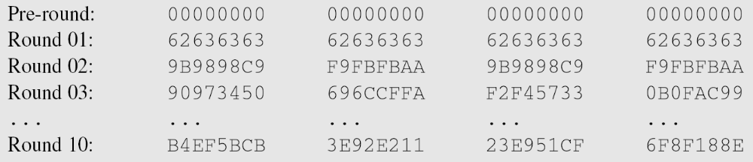
Weak Keys ?
The concept of weak keys, as in DES does not apply to AES. Assume that all bits in the cipher key are 0s. The following shows the words for some rounds:
The words in the pre-round and the first round are all the same. In the second round, the first word matches with the third; the second word matches with the fourth. However, after the second round the pattern disappears; every word is different.

Slide 29
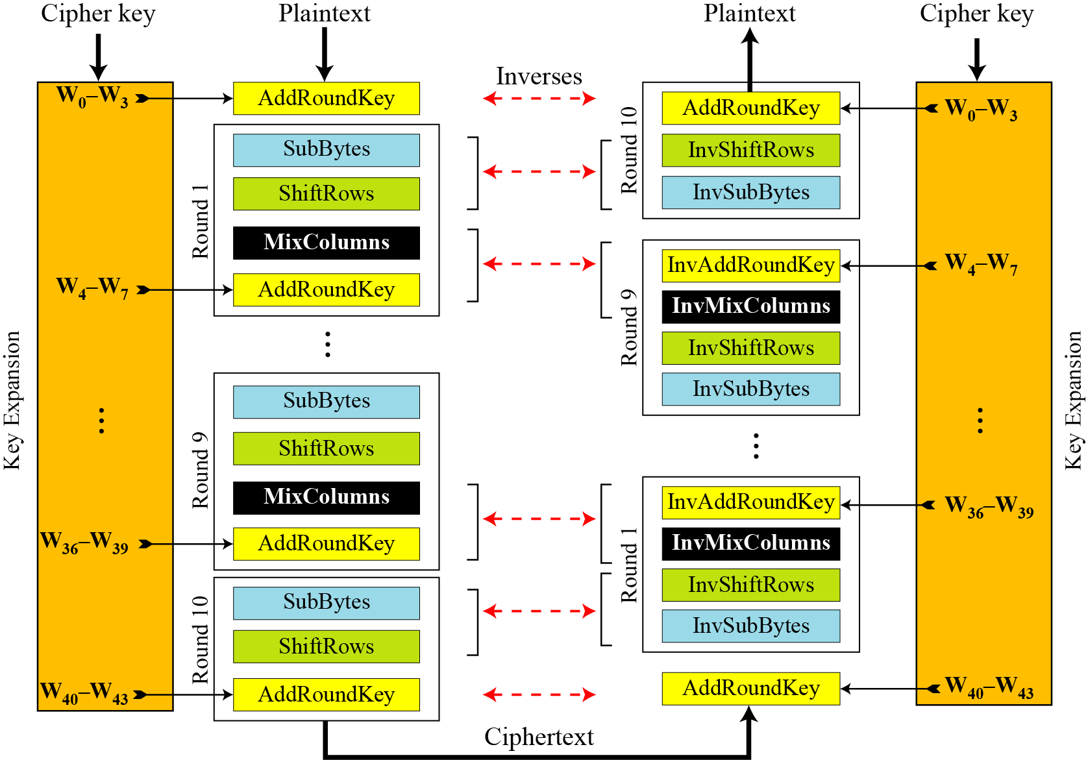
AES Cipher and reverse cipher

Slide 30
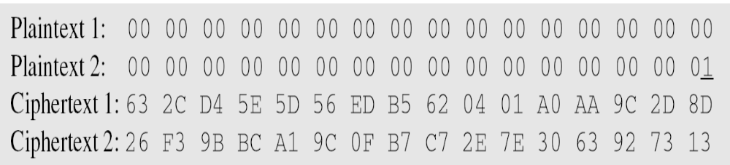
Avalanche effect
Let us change only one bit in the plaintext and compare the results. We changed only one bit in the last byte. The result clearly shows the effect of diffusion and confusion. Changing a single bit in the plaintext has affected many bits in the ciphertext.

Slide 31
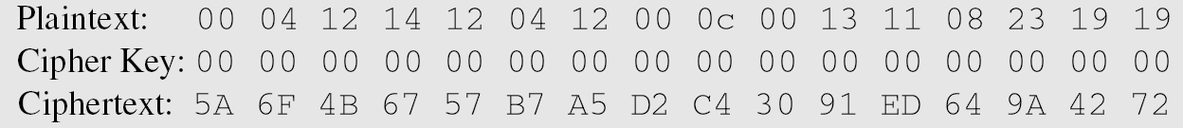
The following shows the effect of using a cipher key in which all bits are 0s.

Slide 32
Security of AES
AES was designed after DES. Most of the known attacks on DES were already tested on AES.
Brute-Force Attack
AES is definitely more secure than DES due to the larger-size key.
Statistical Attacks
Numerous tests have failed to do statistical analysis of the ciphertext.

Slide 33
Simplicity and Cost
AES can be implemented in software, hardware, and firmware. The implementation can use table lookup process or routines that use a well-defined algebraic structure.
The algorithms used in AES are so simple that they can be easily implemented using cheap processors and a minimum amount of memory.

Slide 34
